Slide 1

Concurrent Separation Logic
Thomas Wies

Slide 2


Slide 3
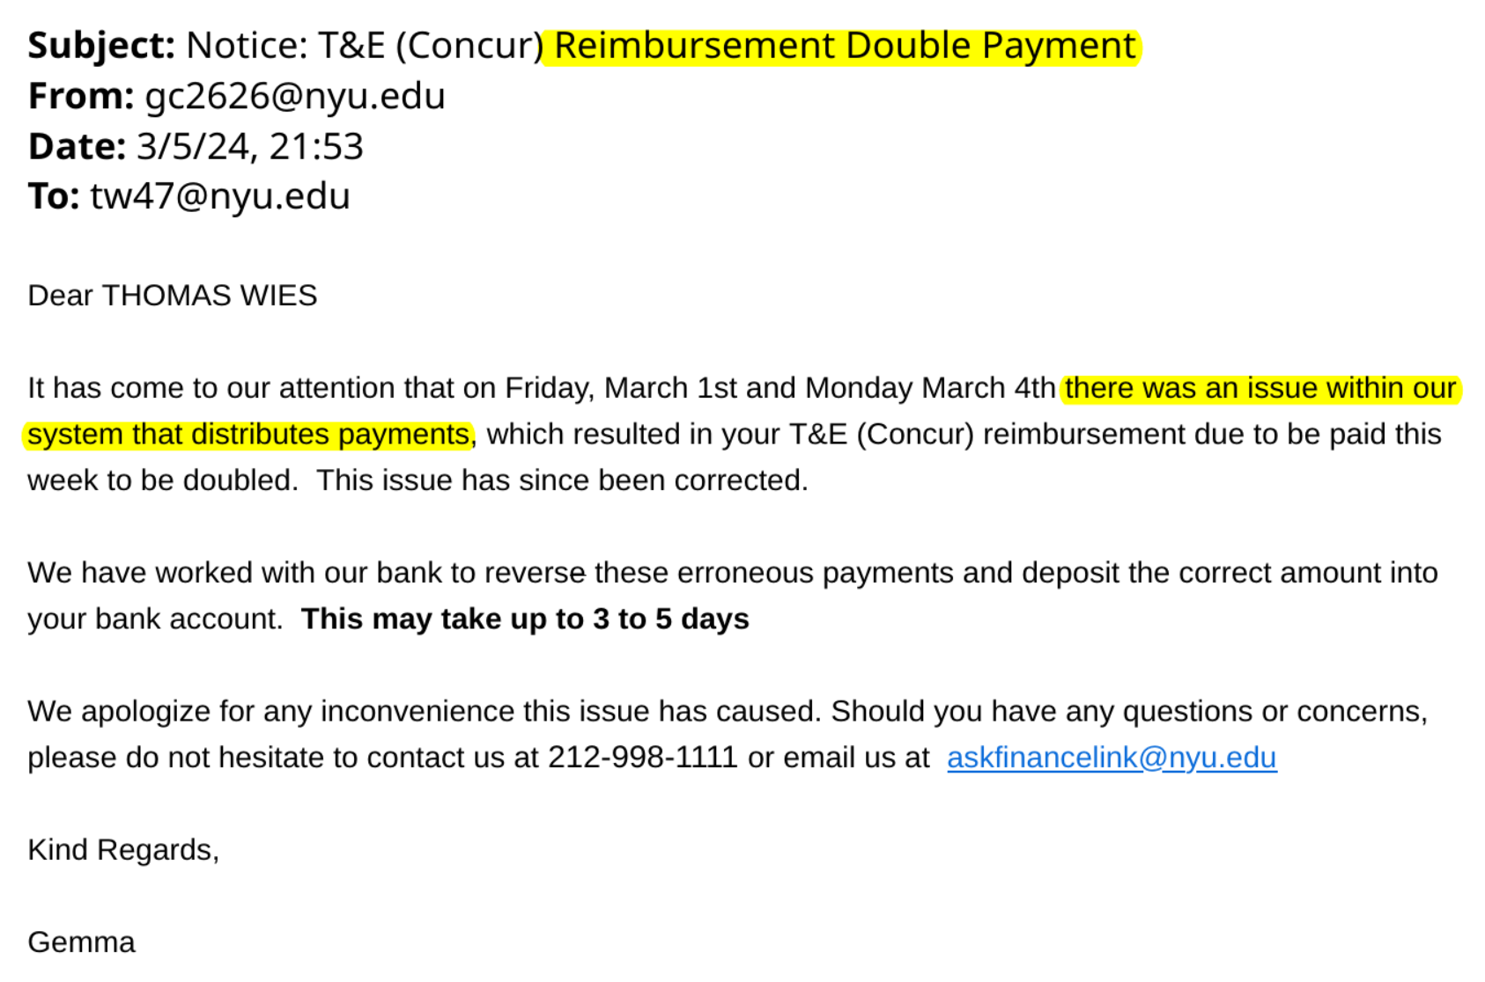


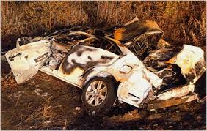


Real-world consequences of concurrency bugs
Therac 25 radiation therapy fatalities (1985)
Northeastern Blackout (2003)
Toyota unintended acceleration
problem (2010)
Linux security vulnerability (2016-2018)
Cloud service outage (2025)

Slide 4
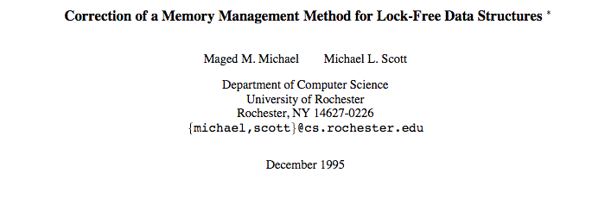
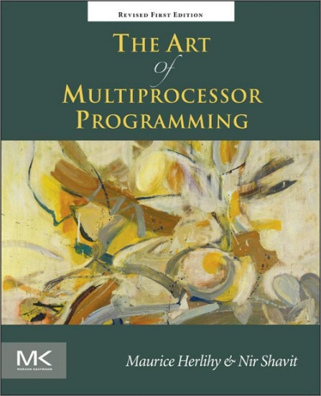
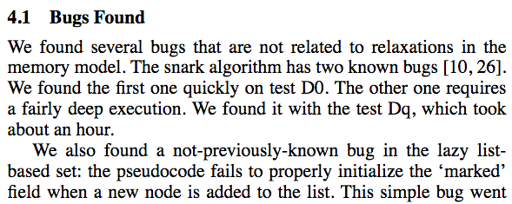
Even concurrency experts make mistakes…
[Burckhardt et al., PLDI ‘07]
[Meyer, W., Wolff, PLDI ‘23]
Notes:
Even peer-reviewed articles by world experts get concurrent algorithms wrong
Important class of algorithms: data structures

Slide 5
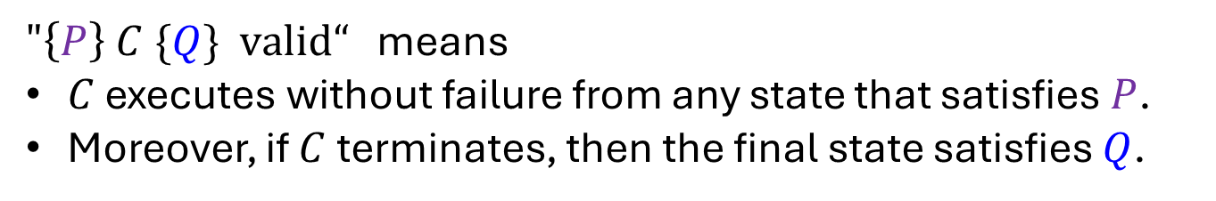

Separation Logic
[O’Hearn, Reynolds, Yang ‘01] [Reynolds ‘02]
$$\left\{P\right\} C \{Q\}$$
precondition
program / command
postcondition
$"\left\{P\right\} C \{Q\} \text{valid}“$ means
$C$ executes without failure from any state that satisfies $P$.
Moreover, if $C$ terminates, then the final state satisfies $Q$.

Slide 6
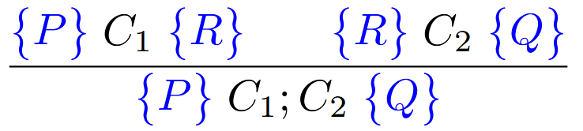
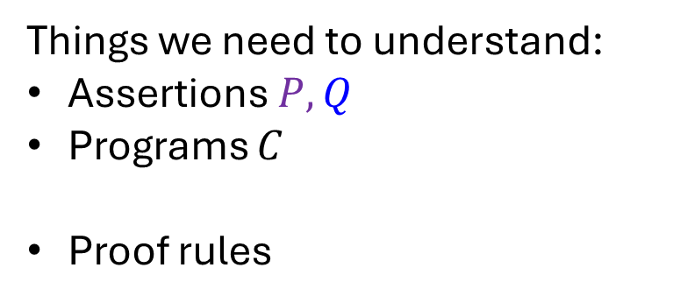
Separation Logic
[O’Hearn, Reynolds, Yang ‘01] [Reynolds ‘02]
$$\left\{P\right\} C \{Q\}$$
precondition
program / command
postcondition
Things we need to understand:
Assertions $P,Q$
Programs $C$
Proof rules

Slide 7




Separation Logic Assertions
$$x.f↦y$$
$$∗ y.f↦y$$
“Points-to” predicate
Separating conjunction
$$f$$
x
$$f$$
y
y

Slide 8

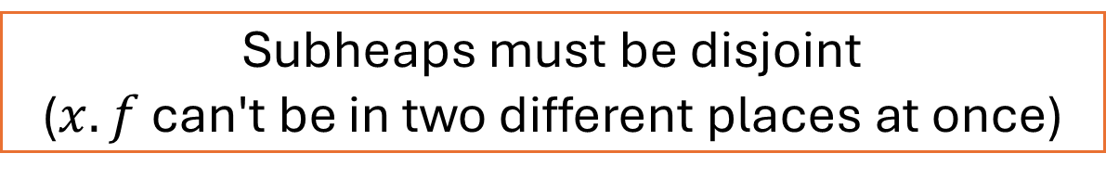
Separation Logic Assertions
$$x.f↦y$$
$$∗ x.f↦z$$
?
unsatisfiable
Subheaps must be disjoint
($x.f$ can't be in two different places at once)

Slide 9



Separation Logic Assertions
$$x.f↦y$$
$$∗ x.g↦z$$
?
x
$$f$$
y
$$g$$
z

Slide 10

Separation Logic Assertion Semantics
Domains
  references: $\text{Ref}$
  values: $Val=\text{Ref} ∪ …$
  fields: $\text{Fld}$
  (program) variables: $\text{Var}$
A state $σ∈Σ$ is a pair $\text{(}\text{h}\text{,}\text{s}\text{)}$ of a stack $s$ and a heap $h$
  $\text{s}∈\text{Var}→\text{Val}$
  $\text{h}∈\text{Ref}×\text{Fld} \text{⇀} \text{Val}$
Composition of states
  $\left(h_{1}, s_{1}\right)∗$ $\left(h_{2}, s_{2}\right)=\left\{\begin{aligned}\left(h_{1}⊎h_{2},s_{1}\right) \text{if} s_{1}=s_{2} \text{and} h_{1}⊥h_{2} \\ \text{undefined} \text{otherwise}\end{aligned}\right.$
  Here, $h_{1}⊥h_{2}$means domains of $h_{1}$ and $h_{2}$ are disjoint

Slide 11

Separation Logic Assertion Semantics
$\left(s,h\right)⊨x.f↦y ⇔ \left(s\left(x\right),f\right)∈dom\left(h\right) \text{and} h\left(s\left(x\right),f\right)=s(y)$
$σ⊨P∗Q ⇔ ∃σ_{1},σ_{2}. σ=σ_{1}∗σ_{2} \text{and} σ_{1}⊨P \text{and} { σ}_{2}⊨Q$
… rest as in classical (first-order) logic

Slide 12
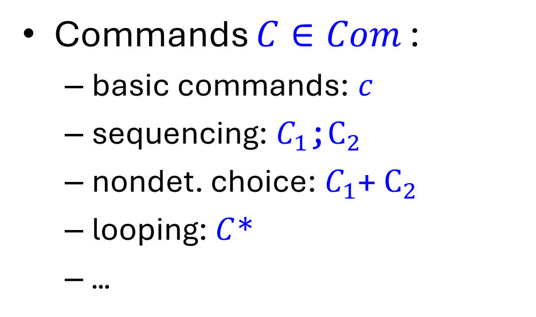
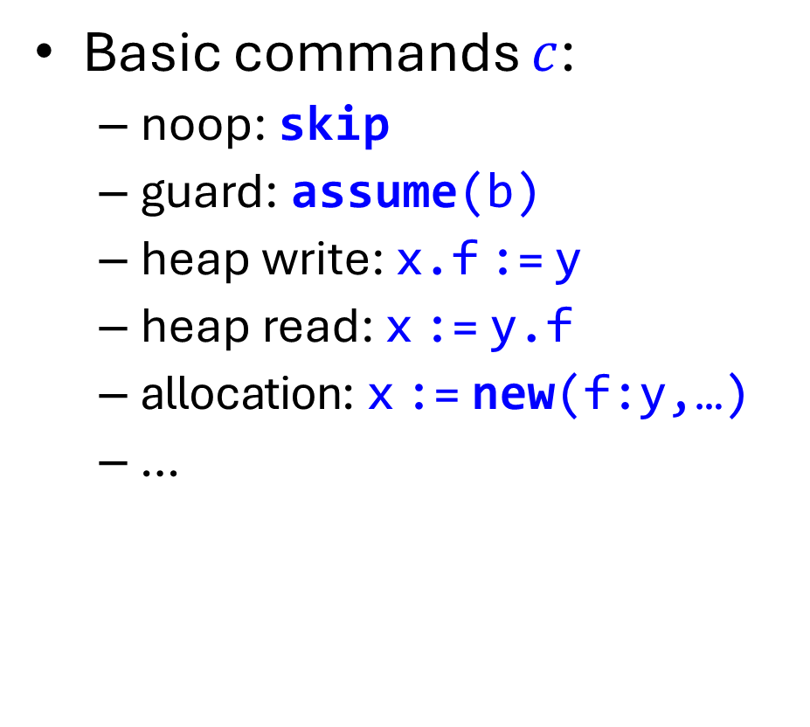
Programs: Syntax
Basic commands $c$:
  noop: skip
  guard: assume(b)
  heap write: x.f := y
  heap read: x := y.f
  allocation: x := new(f:y,…)
  …
Commands $C∈Com$:
  basic commands: $c$
  sequencing: $C_{1}\text{;}C_{2}$
  nondet. choice: $C_{1}\text{+}{ C}_{2}$
  looping: $C$*
  …

Slide 13

Programs: Operational Semantics
Reduction relation
$→ ⊆\left(\text{Com}×Σ\right)×\left(\text{Com}×Σ∪\{\text{abort}\}\right)$
  Notation: $\left(C,σ\right)→(C^{′},σ^{′})$
  Meaning: $C$ takes a step in state $σ$, yielding continuation $C′$and new state $σ^{′}$
Example: semantics of heap writes
  $\left(\text{x}\text{.}\text{f}\text{:=}\text{y},σ\right)→\left(\text{skip},σ^{′}\right)$if $σ=\left(h,s\right) \text{and} \left(s(\text{x}),\text{f}\right)∈dom\left(h\right)$
  $\text{and} σ^{′}=(h\left[\left(\text{x},\text{f}\right)↦s\left(\text{y}\right)\right],s)$
  $\left(\text{x}\text{.}\text{f}\text{:=}\text{y},σ\right)→$ abort if $σ=\left(h,s\right) \text{and} \left(s(\text{x}),\text{f}\right)∉dom\left(h\right)$

Slide 14

Hoare Triples Formally
$"\left\{P\right\} C \{Q\} \text{valid}“$ means
$C$ executes without failure from any state that satisfies $P$.
Moreover, if $C$ terminates, then the final state satisfies $Q$.
formally: for all $σ, σ′$
if $σ⊨P \text{then} \left(C, σ\right) {\text{↛}}^{∗}$ abort
if $σ⊨P \text{and} \left(C, σ\right) →^{∗}$ $\left(\text{skip}, σ′\right)$ $\text{then} σ′⊨Q$

Slide 15

Separation Logic Proof Rules
[Alloc] $\text{\{}\text{true}\text{\} }\text{x}≔\text{new}\text{(}\text{f}\text{:}\text{y}\text{)} \text{\{}\text{x}\text{.}\text{f}↦$ $\text{y}\text{\}}$
[Write] $\text{\{}\text{x}\text{.}\text{f}↦\text{v}\text{\}} \text{x}\text{.}\text{f}≔\text{y} \text{\{}\text{x}\text{.}\text{f}↦\text{y}\text{\}}$
[Read] $\text{\{}\text{x}\text{.}\text{f}↦\text{v}\text{\} }\text{y}≔\text{x}\text{.}\text{f} \text{\{}\text{x}\text{.}\text{f}↦\text{v} ∗ \text{y}=\text{v}\text{\}}$
[Seq]

Slide 16








Frame Rule
$$F$$
$$P$$
$\left\{P\right\}$ $C$ $\left\{Q\right\}$
[Frame]
$$⇝$$
$$C$$
$\left\{P∗F\right\}$ $C$ $\left\{Q∗F\right\}$
$$F$$
$$Q$$
Notes:
Works because * enforces disjointness!

Slide 17
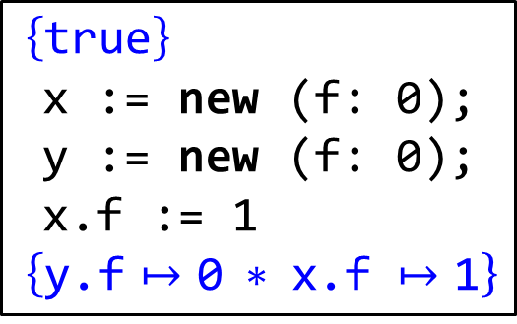

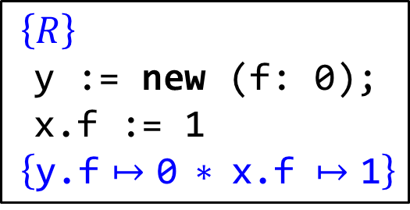
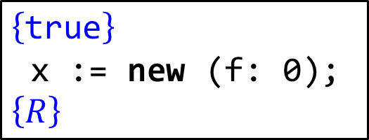
Example Proof
[Seq]
$$\left\{\text{true}\right\}$$
x := new (f: 0);
$$\left\{R\right\}$$
$\left\{\text{true}\right\}$
x := new (f: 0);
y := new (f: 0);
x.f := 1
$\left\{\text{y}\text{.}\text{f}↦\text{0} ∗ \text{x}\text{.}\text{f} ↦\text{1}\right\}$
[Seq]
$R$?
$\left\{R\right\}$
y := new (f: 0);
x.f := 1
$\left\{\text{y}\text{.}\text{f}↦\text{0} ∗ \text{x}\text{.}\text{f} ↦\text{1}\right\}$

Slide 18

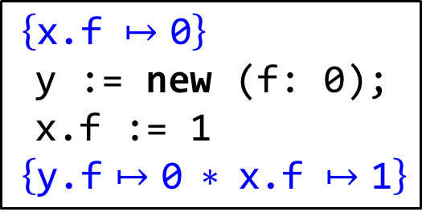
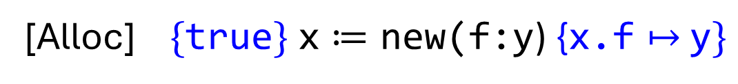

Example Proof
[Alloc] $\text{\{}\text{true}\text{\} }\text{x}≔\text{new}\text{(}\text{f}\text{:}\text{y}\text{)} \text{\{}\text{x}\text{.}\text{f}↦$ $\text{y}\text{\}}$
$$\left\{\text{true}\right\}$$
x := new (f: 0);
$$\left\{\text{x}\text{.}\text{f} ↦\text{0}\right\}$$
[Alloc]
$$\left\{\text{true}\right\}$$
x := new (f: 0);
$$\left\{R\right\}$$
$\left\{\text{true}\right\}$
x := new (f: 0);
y := new (f: 0);
x.f := 1
$\left\{\text{y}\text{.}\text{f}↦\text{0} ∗ \text{x}\text{.}\text{f} ↦\text{1}\right\}$
[Seq]
$\left\{R\right\}$
y := new (f: 0);
x.f := 1
$\left\{\text{y}\text{.}\text{f}↦\text{0} ∗ \text{x}\text{.}\text{f} ↦\text{1}\right\}$
$\left\{\text{x}\text{.}\text{f} ↦\text{0}\right\}$
y := new (f: 0);
x.f := 1
$\left\{\text{y}\text{.}\text{f}↦\text{0} ∗ \text{x}\text{.}\text{f} ↦\text{1}\right\}$

Slide 19


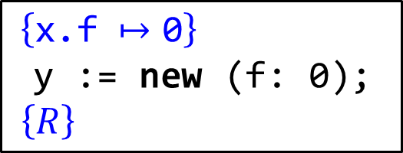


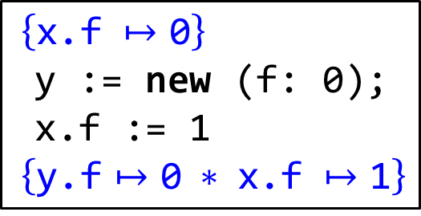





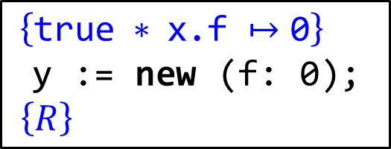

Example Proof
[Alloc] $\text{\{}\text{true}\text{\} }\text{x}≔\text{new}\text{(}\text{f}\text{:}\text{y}\text{)} \text{\{}\text{x}\text{.}\text{f}↦$ $\text{y}\text{\}}$
$\left\{P\right\}$ $C$ $\left\{Q\right\}$
[Frame]
$\left\{P∗F\right\}$ $C$ $\left\{Q∗F\right\}$
$$P$$
$$F$$
$\left\{\text{x}\text{.}\text{f} ↦\text{0}\right\}$
y := new (f: 0);
$\left\{R\right\}$
$\left\{\text{true} ∗ \text{x}\text{.}\text{f} ↦\text{0}\right\}$
y := new (f: 0);
$\left\{Q∗F\right\}$
$\left\{\text{true} ∗ \text{x}\text{.}\text{f} ↦\text{0}\right\}$
y := new (f: 0);
$\left\{R\right\}$
$\left\{\text{true}\right\}$
y := new (f: 0);
$\left\{\text{y}\text{.}\text{f}↦\text{0}\right\}$
$$P$$
$\left\{\text{x}\text{.}\text{f} ↦\text{0}\right\}$
y := new (f: 0);
x.f := 1
$\left\{\text{y}\text{.}\text{f}↦\text{0} ∗ \text{x}\text{.}\text{f} ↦\text{1}\right\}$
$$Q$$
[Seq]
$\left\{R\right\}$
x.f := 1;
$\left\{\text{y}\text{.}\text{f}↦\text{0} ∗ \text{x}\text{.}\text{f} ↦\text{1}\right\}$
$\left\{Q∗F\right\}$
x.f := 1
$\left\{\text{y}\text{.}\text{f}↦\text{0} ∗ \text{x}\text{.}\text{f} ↦\text{1}\right\}$

Slide 20
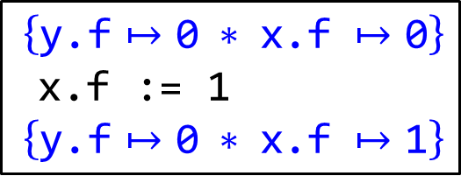
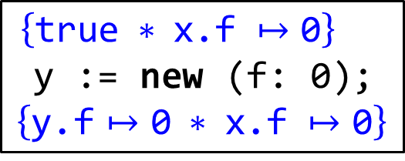
Example Proof
[Alloc] $\text{\{}\text{true}\text{\} }\text{x}≔\text{new}\text{(}\text{f}\text{:}\text{y}\text{)} \text{\{}\text{x}\text{.}\text{f}↦$ $\text{y}\text{\}}$
$\left\{P\right\}$ $C$ $\left\{Q\right\}$
[Frame]
$\left\{P∗F\right\}$ $C$ $\left\{Q∗F\right\}$
$\left\{\text{x}\text{.}\text{f} ↦\text{0}\right\}$
y := new (f: 0);
$\left\{R\right\}$
$\left\{\text{true} ∗ \text{x}\text{.}\text{f} ↦\text{0}\right\}$
y := new (f: 0);
$$\left\{\text{y}\text{.}\text{f}↦\text{0} ∗ \text{x}\text{.}\text{f} ↦\text{0}\right\}$$
$\left\{\text{true} ∗ \text{x}\text{.}\text{f} ↦\text{0}\right\}$
y := new (f: 0);
$\left\{R\right\}$
$\left\{\text{true}\right\}$
y := new (f: 0);
$\left\{\text{y}\text{.}\text{f}↦\text{0}\right\}$
$\left\{\text{x}\text{.}\text{f} ↦\text{0}\right\}$
y := new (f: 0);
x.f := 1
$\left\{\text{y}\text{.}\text{f}↦\text{0} ∗ \text{x}\text{.}\text{f} ↦\text{1}\right\}$
[Seq]
[Frame]
$\left\{\text{y}\text{.}\text{f}↦\text{0} ∗ \text{x}\text{.}\text{f} ↦\text{0}\right\}$
x.f := 1
$\left\{\text{y}\text{.}\text{f}↦\text{0} ∗ \text{x}\text{.}\text{f} ↦\text{1}\right\}$
[Alloc]

Slide 21
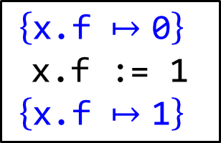
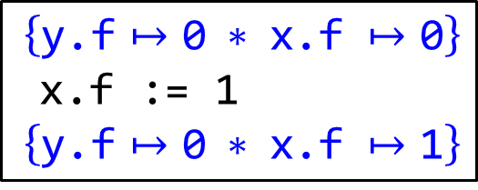

Example Proof
[Write] $\text{\{}\text{x}\text{.}\text{f}↦\text{v}\text{\}} \text{x}\text{.}\text{f}≔\text{y} \text{\{}\text{x}\text{.}\text{f}↦\text{y}\text{\}}$
$\left\{\text{y}\text{.}\text{f}↦\text{0} ∗ \text{x}\text{.}\text{f} ↦\text{0}\right\}$
x.f := 1
$\left\{\text{y}\text{.}\text{f}↦\text{0} ∗ \text{x}\text{.}\text{f} ↦\text{1}\right\}$
$\left\{\text{x}\text{.}\text{f} ↦\text{0}\right\}$
x.f := 1
$\left\{\text{x}\text{.}\text{f} ↦\text{1}\right\}$
[Write]
[Frame]

Slide 22

Raven Demo
[Gupta, Patel, W. CAV’25]
Try it out!
https://github.com/nyu-acsys/raven

Slide 23





Concurrent Separation Logic
[O’Hearn ‘04] [Brooks ‘04]
$\left\{P1\right\}$ $C1$ $\left\{Q1\right\}$
$\left\{P2\right\}$ $C2$ $\left\{Q2\right\}$
[Par]
$\left\{P1∗P2\right\}$ $C1 || C2 \left\{Q1∗Q2\right\}$
$\left\{\text{true}\right\}$
val x := new (count: 0);
val y := new (count: 0);
faa(x.count, 2)
faa(y.count, 2)
$\left\{\text{x}\text{.}\text{count}↦2∗\text{y}\text{.}\text{count}↦2\right\}$
“fetch-and-add”
atomic {
y.count := y.count + 2
}

Slide 24






Concurrent Separation Logic
[O’Hearn ‘04] [Brooks ‘04]
$\left\{P1\right\}$ $C1$ $\left\{Q1\right\}$
$\left\{P2\right\}$ $C2$ $\left\{Q2\right\}$
[Par]
$\left\{P1∗P2\right\}$ $C1 || C2 \left\{Q1∗Q2\right\}$
$\left\{\text{true}\right\}$
val x := new (count: 0);
val y := new (count: 0);
$\left\{\text{x}\text{.}\text{count}↦0∗\text{y}\text{.}\text{count}↦0\right\}$
$$\text{\{}\text{x}\text{.}\text{count}↦0\}$$
$$\text{\{}\text{y}\text{.}\text{count}↦0\}$$
faa(x.count, 2)
faa(y.count, 2)
$$\text{\{}\text{x}\text{.}\text{count}↦2\}$$
$$\text{\{}\text{y}\text{.}\text{count}↦2\}$$
$\left\{\text{x}\text{.}\text{count}↦2∗\text{y}\text{.}\text{count}↦2\right\}$

Slide 25

Concurrent Separation Logic
[O’Hearn ‘04] [Brooks ‘04]
$\left\{P1\right\}$ $C1$ $\left\{Q1\right\}$
$\left\{P2\right\}$ $C2$ $\left\{Q2\right\}$
[Par]
$\left\{P1∗P2\right\}$ $C1 || C2 \left\{Q1∗Q2\right\}$
$\left\{\text{true}\right\}$
val x := new (count: 0);
faa(x.count, 2)
faa(x.count, 2)
?
val res := x.count;
$\left\{\text{res}= 4\right\}$

Slide 26




Concurrent Separation Logic
[O’Hearn ‘04] [Brooks ‘04]
$\left\{P1\right\}$ $C1$ $\left\{Q1\right\}$
$\left\{P2\right\}$ $C2$ $\left\{Q2\right\}$
[Par]
$\left\{P1∗P2\right\}$ $C1 || C2 \left\{Q1∗Q2\right\}$
$\left\{\text{true}\right\}$
val x := new (count: 0);
$\left\{\text{x}\text{.}\text{count}↦0\right\}$
$$\text{\{}???\}$$
$$\text{\{}???\}$$
faa(x.count, 2)
faa(x.count, 2)
val res := x.count;
$\left\{\text{res}= 4\right\}$

Slide 27
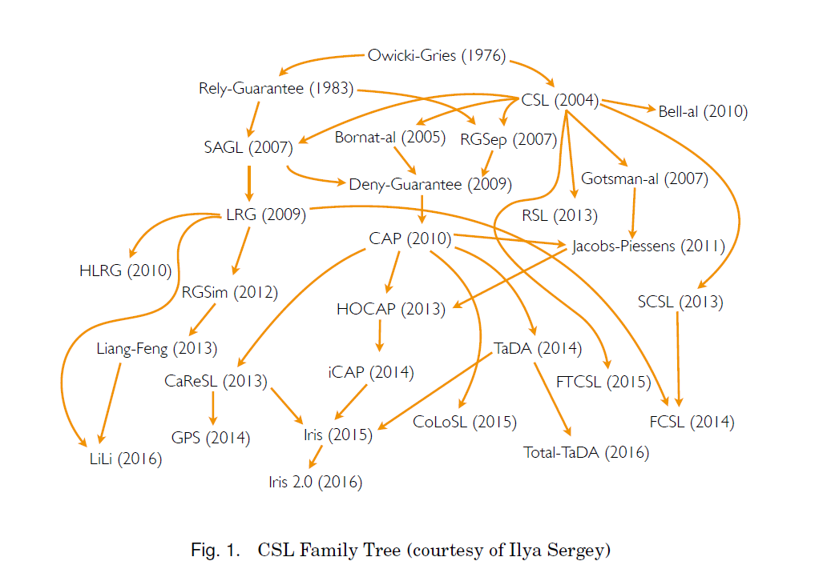

The CSL Jungle
TaDA Live (2019)
Iris 4.5 (2026)
[Jung et al.]

Slide 28


Iris in a nutshell
$\left\{\text{true}\right\}$
val x := new (count: 0);
faa(x.count, 2)
faa(x.count, 2)
val res := x.count;
$\left\{even(\text{res})\right\}$

Slide 29


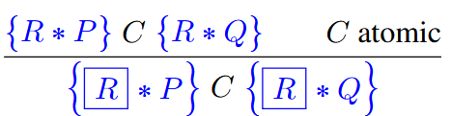
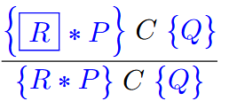

Iris invariants
Invariant assertion expresses that is maintained as an invariant of the program state
Invariant opening
Invariant allocation
Invariant duplication

Slide 30





Iris invariants
val x := new (count: 0);
faa(x.count, 2)
faa(x.count, 2)
val res := x.count;

Slide 31

Iris invariants
val x := new (count: 0);
faa(x.count, 2)
faa(x.count, 2)
val res := x.count;

Slide 32

Iris invariants
val x := new (count: 0);
faa(x.count, 2)
faa(x.count, 2)
val res := x.count;

Slide 33

Proving the stronger postcondition?
val x := new (count: 0);
faa(x.count, 2)
faa(x.count, 2)
val res := x.count;
?

Slide 34
Iris ghost state teaser
Entangled pairs of ghost resources
Update of entangled pair (logical view shift)
New invariant

Slide 35





Iris ghost state
val x := new (count: 0, g: 0, h: 0);
faa(x.count, 2)
faa(x.count, 2)
val res := x.count;

Slide 36


Iris ghost state
val x := new (count: 0, g: 0, h: 0);
faa(x.count, 2)
faa(x.count, 2)
val res := x.count;

Slide 37
Ongoing research directions in CSL
Extensions
  Weak memory consistency
  Liveness properties
  Probabilistic reasoning
  Hyper-properties
  Incorrectness reasoning
  …
Applications
  Formalization of programming language features
  Concurrent and distributed systems verification
Proof automation

